Slide 1



VelX Trinity
EMERGE
Early Mental Emotional Risk Gradient Engine for Students

Slide 2



Problem Statement
Students today face increasing stress, anxiety, and emotional burnout due to academic pressure and social expectations.
Many students do not openly communicate their mental distress because of stigma, fear, or lack of safe expression spaces.
Existing mental health support systems depend on self-reporting or late-stage intervention, which limits early detection.
Subtle emotional and behavioral changes—early warning signs of distress—often go unnoticed.
This delay can lead to serious mental health crises before timely support is provided.
There is a strong need for a preventive, ethical, and non-intrusive solution that respects student privacy and avoids clinical diagnosis.

Slide 3



Proposed Solution
EMERGE is an AI-powered mental health early-warning system designed to support students through ethical personalization and emotional awareness.
The system gently collects reflective inputs and preference-based responses to understand a student’s current mood, comfort patterns, and personality tendencies.
Using longitudinal NLP, EMERGE detects emotional drift over time rather than single emotional moments.
Based on these insights, the platform provides positive quotes from favorite artists, visual mood comparisons, and a gamified virtual companion that grows as emotional well-being improves.
Micro-interventions, reflection prompts, and support suggestions are delivered in a non-clinical, consent-based manner, encouraging emotional resilience without labeling or diagnosis.

Slide 4





Self-Awareness
Recognize and understand your own emotions.
Core Components of Emotional Intelligence
Self-Regulation
Manage reactions and stay composed under pressure.
Motivation
Stay driven and committed to goals.
Empathy
Understand others’ perspectives and feelings.
Social Skills
Build trust, influence, and cooperation.

Slide 5

System Architecture

Slide 6
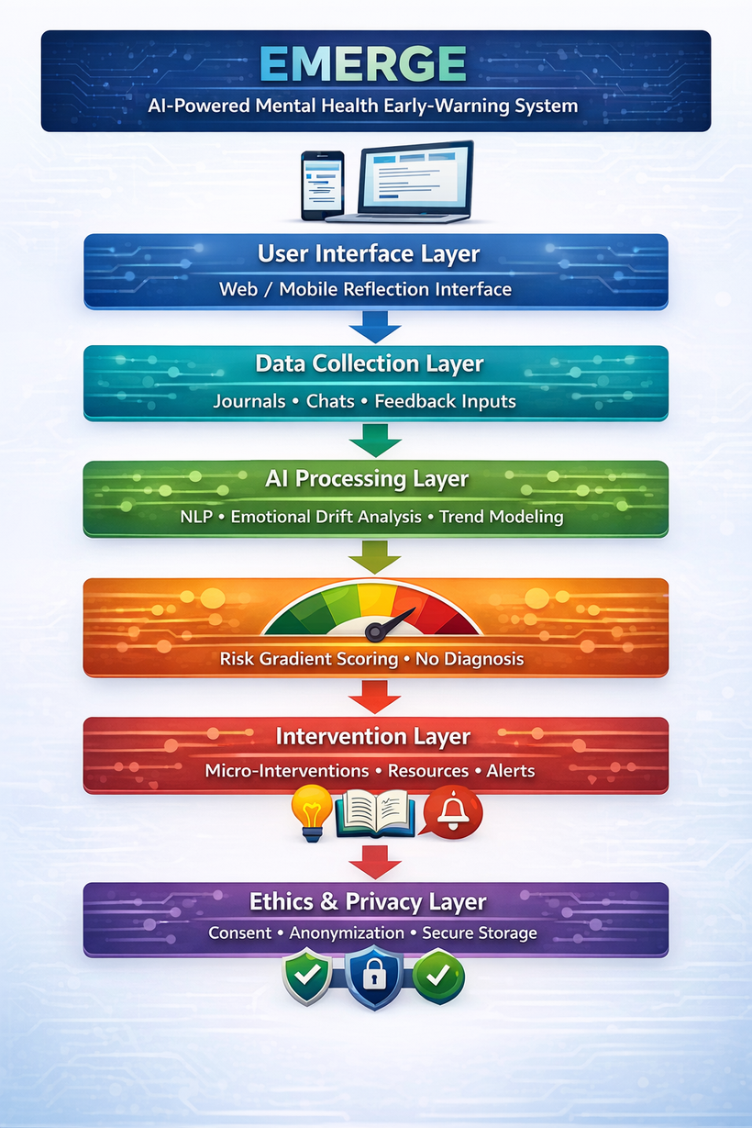

Slide 7

Prototype Workflow

Slide 8
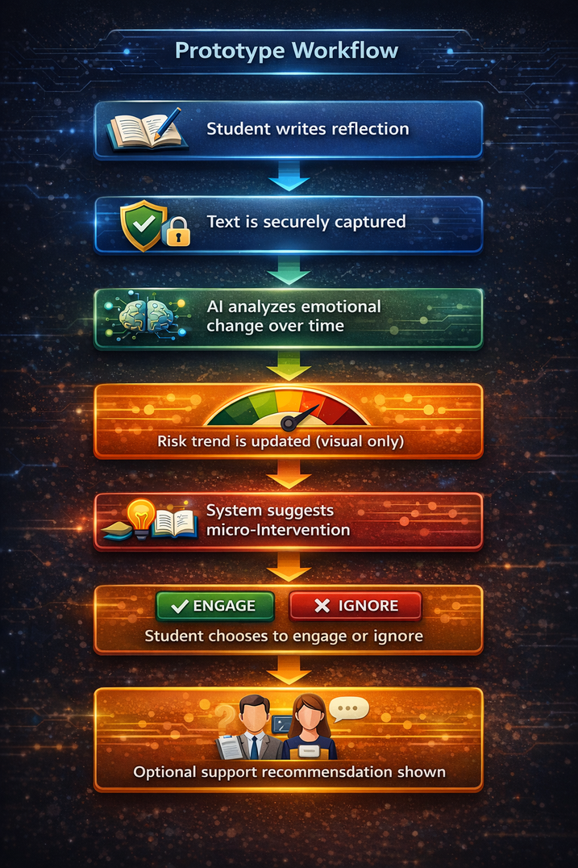

Slide 9
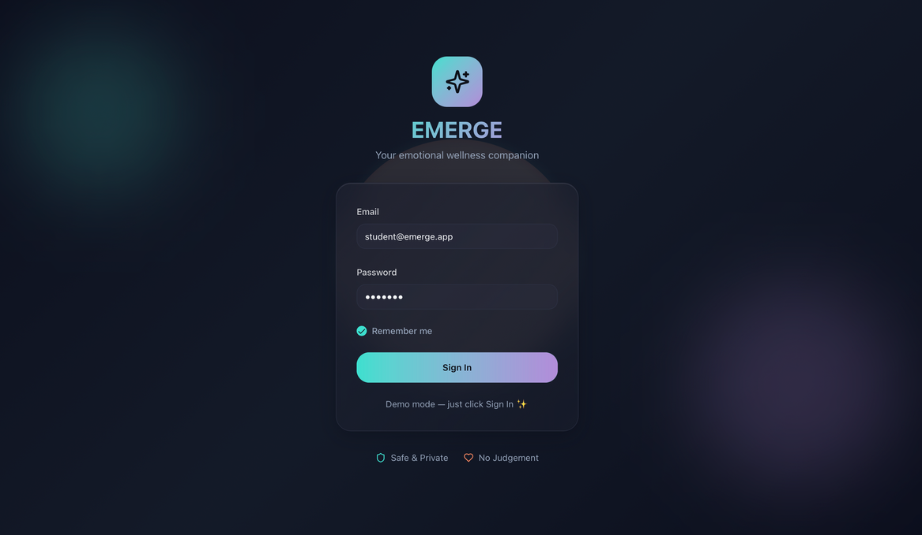
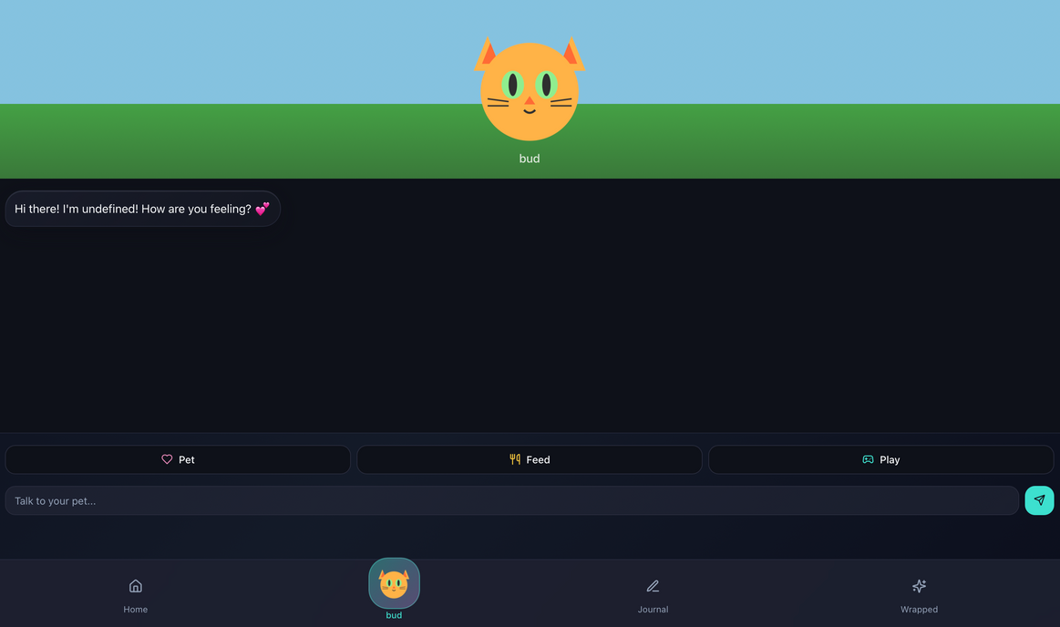
GitHub Repo Link:
https://github.com/shaminisp25-pixel/EMERGE.git

Slide 10

Summary
Emotional intelligence empowers leaders to navigate complexity with empathy and confidence. It helps create a supportive, high-performing environment where people feel heard, respected, and inspired to grow together.

Slide 11

Thank You
Lead with heart and clarity.

